Slide 1
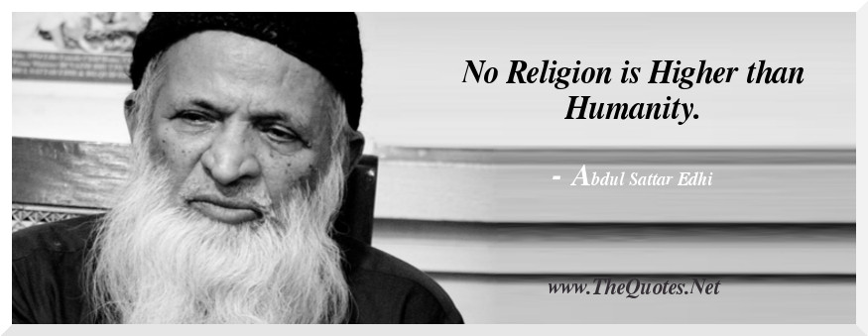
Insaniyat

Slide 2
Group members and supervisor
Members:
Syed Kumail Ali 16k4047
Anas Bin Faisal 16k4064
Abeer Zehra 16k4068
Supervisor:
Engr Abdul Rahman
Co -Supervisor:
Mr. Murataza Munawar

Slide 3
Problem Statement
No platform was where the people of Karachi can donate
Lengthy procedures and laziness becoming hurdle

Slide 4
Motivation
Minimizing the wastage of food
To provide a platform where the privileged could help needy.
Trying to be a helping hand,for people in state of crisis.

Slide 5
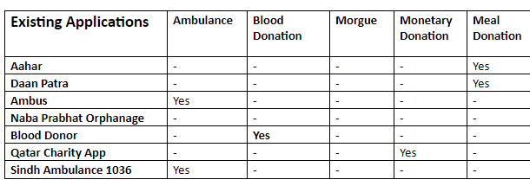
Existing Applications

Slide 6
Our System
Four different applications
Volunteer Application
General User Application
Ambulance Driver Application
Welfare Admin Application

Slide 7
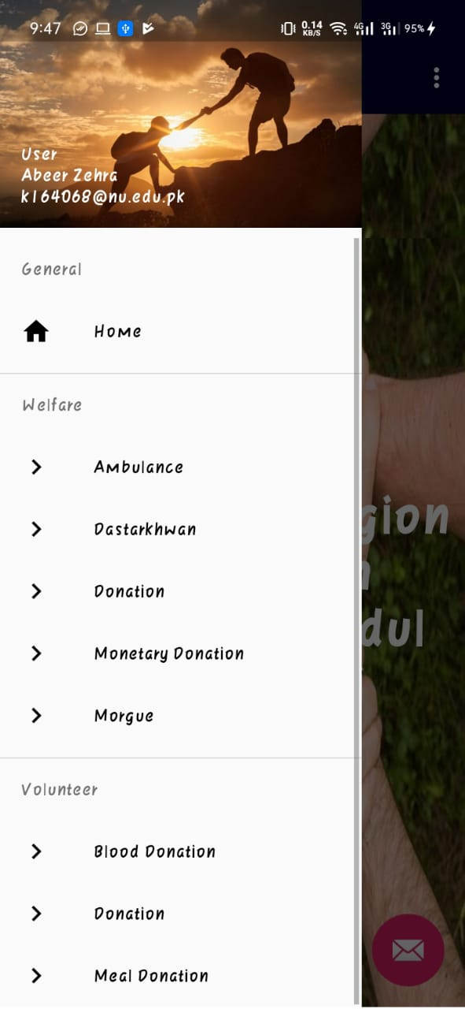
General User Application

Slide 8
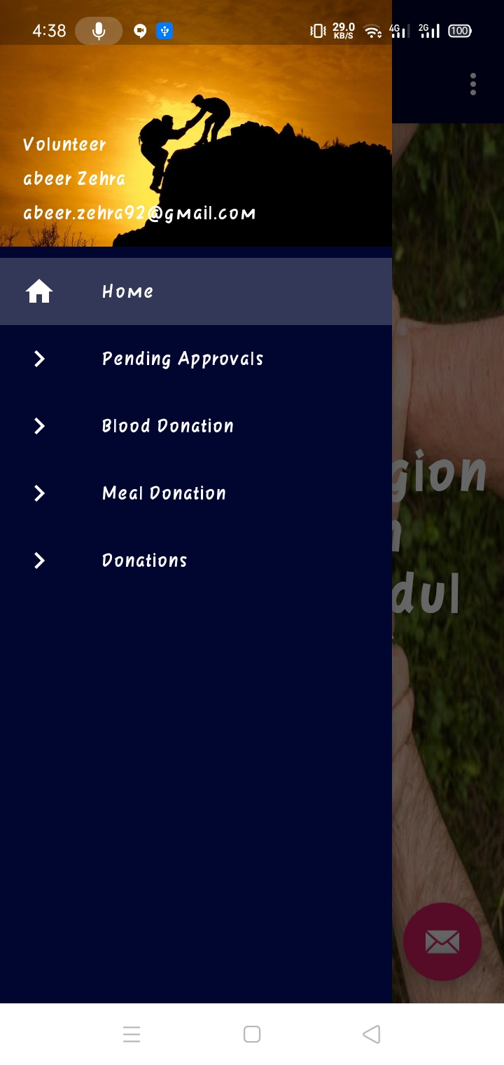
Volunteer Application

Slide 9
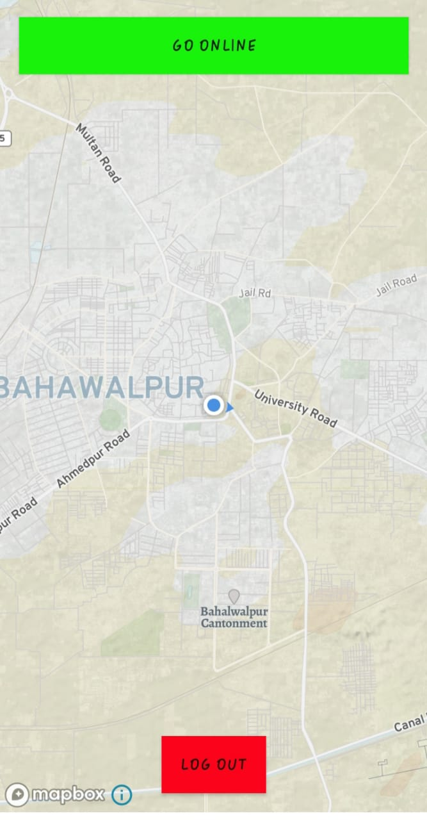
Ambulance Driver Application

Slide 10
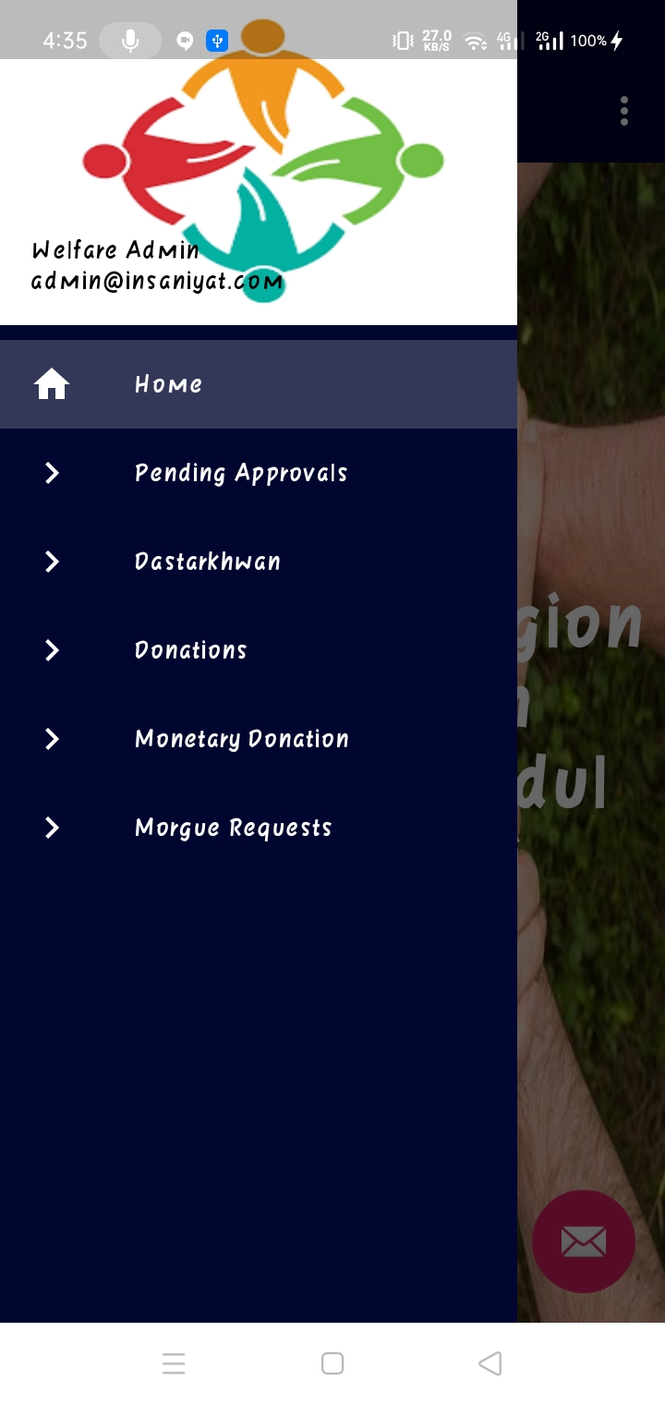
Welfare Admin Application

Slide 11
Any Question?

